Slide 1


SRM TRP ENGINEERING COLLEGE
Department of Electronics and Communication Engineering
STUCTURAL HEALTH MONITORING USING MACHINE LEARNING
Presented by
AKASH.P(814720106005)
ANAS.A(814720106006)
HARISOMAN.K(814720106031)
DEPARTMENT OF ECE
SRM TRP ENGINEERING COLLEGE
TRICHY
Guided by
Mr. G.PARAMESHWARAN
(Asst.Professor)
DEPARTMENT OF ECE
SRM TRP ENGINEERING COLLEGE
TRICHY

Slide 2
SRM TRP ENGINEERING COLLEGE
Department of Electronics and Communication Engineering
Outline - Presentation
Abstract
Introduction
Literature Survey
Existing Methodology
Block diagram / Proposed Methodology
Hardware/ Software Used
Result & Output
Conclusion
References
Publication

Slide 3
SRM TRP ENGINEERING COLLEGE
Department of Electronics and Communication Engineering
Abstract
To identify and quantify structural damage using an accelerometer that employs raw vibration signals from the structure.
To make real time, online monitoring structural damage detection.
Structure Health Monitoring provides a solution for damage detection, identification and monitoring the structural behavior through collection of data from several points on the structure.
In this work, we present the design and operation of an Internet of Things based structural health monitoring system.
The vibration signals are collected from specific points from the monitored structure using a processing node with wireless internet connectivity.
Then, the sensors data are grouped and transmitted via cellular network to a remote server where an appropriate damage detection algorithm is applied on the collected data to assess the status of the structure.
We provide details about the proposed systems design and operation including the hardware and software parts.
The results show the feasibility of the proposed system in automating the damage detection process

Slide 4
INTRODUCTION
Structural monitoring systems encounter two types of challenges: aging, with consequent and gradual loss of operating conditions, and the occurrence of a sudden and unexpected event, as an earthquake.
However, there is a certain heterogeneity in the methods of applying structural monitoring.
The objectives go towards a more precise detection capacity, easier management, and storage of data (even when they are in large quantities), timeliness, and reliability.
he proposed monitoring system for structural health is based on a microcontroller and two triaxial accelerometric sensors.
The data returned, and subsequently suitably processed, allows to determine the identification of the damage indicator on an engrave steel bar.

Slide 5
LITERATURE SURVEY
S.No | PAPER TITLE | AUTHOR | YEAR OF PUB | JOURNAL | LIMITATION
1 | An Approach of Reliable Data Transmission With Random Redundancy for Wireless Sensors in Structural Health Monitoring | Z. Zou, Y. Bao | 2015 | IEEE Sensors Journal | Records status of specific bridge and compares the status with register information manually
2 | Lossless In-Network Processing in WSNs for Domain-Specific Monitoring Applications | P. Guo, J. Cao, and X. Liu | 2017 | IEEE Transactions on Industrial Informatics | Monitoring for these has been paid more attention by the department
3 | Deploying Wireless Sensor Network with Fault-Tolerance for Structural Health Monitoring | Z. Alam, G. Wang | 2015 | IEEE Transactions on Computers | For short-distance communications

Slide 6
EXISTING METHOD
Wireless structural health monitoring system for real-time data acquisition.
This kind of system is limited in the number of sensors and the capability of the synchronization of the samples.
Invasive seismic events is a existing research field, and this kind of system can read warning signal from the inside concrete when an event occurs.
That it requires a very complicated hardware and software setup with low final performance.
Indeed, to increase the sampling rate, the number of sensors connected in the same network decreases.

Slide 7
PROPOSED METHOD
The proposed system is to know the integrity of in-service structures on a continuous real-time basis that leads to function of safety maintenance and extending the life time of real time buildings.
Identifying and detecting weaknesses and damages in the infrastructure due to aging or any other reason, well in time so that a preventive maintenance can be undertaken before it collapses.
Using a sensing module which mainly detects the vibration in the structure and then the data will be transmitted to the Arduino.
When the sensor is placed in the structure, it detects the vibration and sends the information to the arduino.
Arduino is programmed in such a way that if the vibration is more than the preset value it alerts the user.
The measurements can take place in every light condition.
This model turns out to be very economical and cost effective, compared to all the other present day technologies involving structural damage detection.

Slide 8
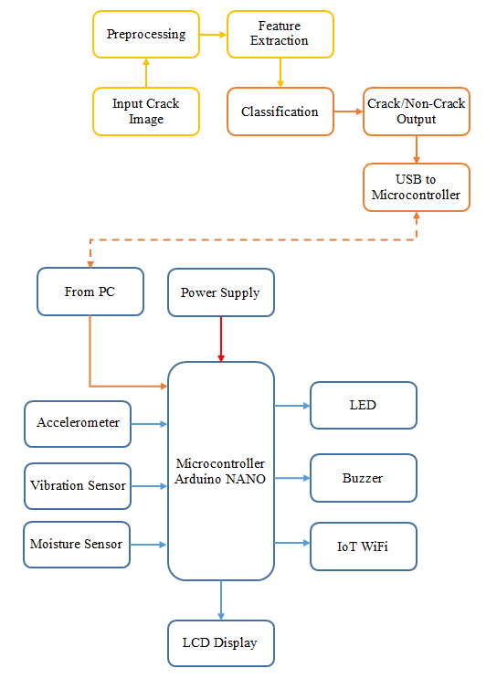

PROPOSED METHOD
BLOCK DIAGRAM

Slide 9
PROPOSED METHOD
EXPLANATION
The system is developed using sensor unit which consists of vibration sensor (Accelerometer-MPU6050), Strain sensor, Moisture sensor;
Data acquisition and processing unit which includes Arduino NANO and Wi-Fi module(ESP8266) that process and transfer sensed data on cloud.
Data collected by Arduino NANO is also given to the visual studio for locally storing data and visualizing data on the bar chart form as shown in Fig.
This stored data is accessed by users. This enables user to check current state of the building and take necessary steps toward it. Alert will be given for initiating preventive maintenance service if emissions caused by structures are beyond reasonable limits.

Slide 10
SRM TRP ENGINEERING COLLEGE
Department of Electronics and Communication Engineering
SYSTEM REQUIREMENTS
H/W System Configuration
Microcontroller Arduino NANO
MEMS Sensor – MPU6050
Vibration Sensor
Buzzer
LCD display
Power supply
PC
S/W System Configuration
Arduino Ide
Operation System - Windows 7 Or 8
Programming Language – MATLAB 2018a

Slide 11
SRM TRP ENGINEERING COLLEGE
Department of Electronics and Communication Engineering
HARDWARE DESCRIPTION
ARDUINO NANO
Arduino is an open source platform for prototyping based on user-friendly software. It provides a flexible base for engineers to experiment on designing interactive environments. Its main components are
14 digital input/output pins ( 6 can be used as PWM outputs)
6 analog inputs(can also be used for digital I/O - so a total of 20 digital I/O's)
16 MHz crystal oscillator
USB connection
reset button
Accelerometer
The MPU-6050™ parts are the world’s first Motion Tracking devices designed for the low power, low cost, and high-performance requirements of wearable sensors. MPU6050 sensor module is complete 6-axis Motion Tracking Device. It combines 3-axis Gyroscope, 3-axis Accelerometer and Digital Motion Processor all in small package. Also, it has additional feature of on-chip Temperature sensor. It has I2C bus interface to communicate with the microcontrollers.

Slide 12
SRM TRP ENGINEERING COLLEGE
Department of Electronics and Communication Engineering
RESULT AND OUTPUT
Experimental Setup Output
The algorithm works as expected and performs real-time processing, classification and PC communication achieving very promising preliminary results

Slide 13
SRM TRP ENGINEERING COLLEGE
Department of Electronics and Communication Engineering
CONCLUSION
This system helps government to issue early warning of any unwanted critical condition for resident based on cloud data. This has the main advantages of reducing costs and facilitating the spreading of the technology. It assures higher speed, lower power consumption and safeguards from data. So that, they can take a legal action earlier before it collapses. With increasing investments in civil infrastructure, people are facing huge problems related to rise in water content in the wall and aging of infrastructure. With keeping the above issues in mind, this framework is designed that will effectively monitor current state of buildings. Therefore, appropriate actions can be taken in a time to avoid accidents.

